Slide 1
IBM BoB AI Innovation Hackathon
Team Name: Arcturus

Slide 2
Team members
Team Leader:
  Om Patel
Team members:
  Gyan Patel
  Smit Tandel
  Pratham Patel

Slide 3
Problem Statement
During intense storm events across major utility sectors in Gujarat, grid operations desks face extreme visibility issues because live sensor data, localized weather data, and crew logs are completely split across disconnected software tools. When high-voltage infrastructure begins failing under environmental stress, control rooms lack a single unified tool to process real-time satellite captures and calculate immediate equipment threat variables. This missing link forces engineers to act blindly, extends cascade power blackout durations, and leaves emergency field teams stranded in dangerous territory without predictive route profiling.

Slide 4
Proposed Solution
We built GridGuard, a high-efficiency power management web application running a Django REST Framework backend coupled to an animated Vanilla HTML/CSS/JS topological operations timeline canvas.
The core system enables operators to drag and drop raw satellite screen captures directly onto the operational interface. The Django application translates the pixel arrays using an offline machine learning logic model (.pkl) to extract instant regional rainfall metrics. Simultaneously, the system queries the live open-source Open-Meteo API using coordinate vectors to inject ambient environmental parameters (wind thresholds and temperatures) straight into a composite asset evaluation calculation.
This results in an instant 0–100% Outage Risk rating map accompanied by an animated vertical transit pipeline that visually guides emergency crews to high-threat grid components before cascade failures occur.

Slide 5
Key features
Satellite Image Inference
Live Environmental Synthesis
Proximity Fallback Routing
Operator Synchronization Controls
Animated Transit Pipeline

Slide 6
Tech Stack
Category : Technologies
Languages : Python, Javascript, HTML, CSS
Frameworks : Django, Django REST Framework
IBM Technologies : IBM Bob
Databases : Local JSON Data Arrays
Other : Joblib, Scikit-Learn, Numpy, Pandas, Pillow, Requests, django- cors-headers

Slide 7
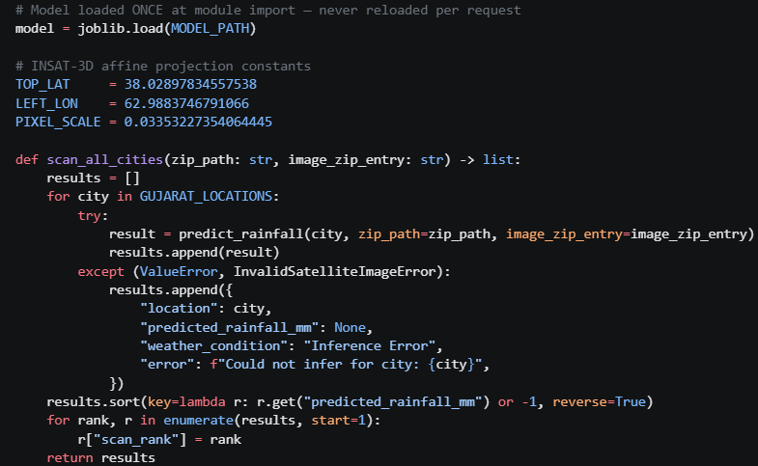
Backend
Code:
Explanation:
This part of the code is used to implement Satellite Image Inference.
POST /api/satellite-scan/ accepts a single .tif image path inside archive.zip. For each of the 18 Gujarat cities, it projects the city's WGS-84 coordinates onto the INSAT-3D raster using the affine constants, averages a 3×3 pixel neighbourhood with NumPy, builds a 5-feature Pandas DataFrame, and runs it through the pre-loaded scikit-learn model (joblib.load at import time — never reloaded per request). Results are sorted by predicted_rainfall_mm descending and tagged with a scan_rank. Per-city errors are caught individually so one bad pixel never aborts the full scan.

Slide 8
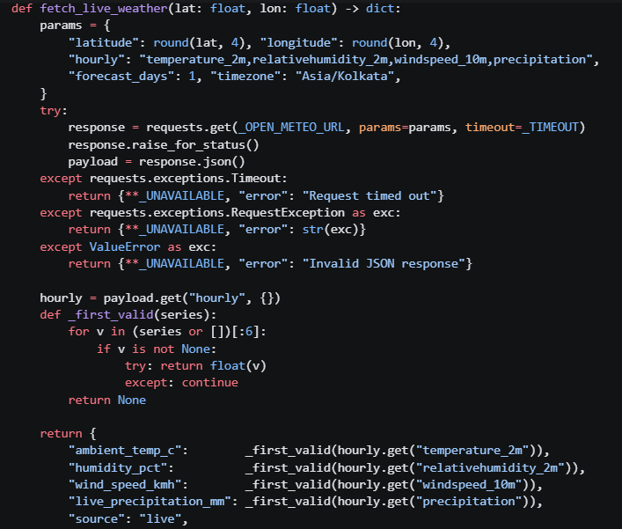
backend
Code:
Explanation:
This part of the code is used to implement Live Environmental Synthesis.
GET /api/live-environment/ loops every city in _CITY_COORDS, calls fetch_live_weather() which hits the Open-Meteo REST API with a 5-second timeout and never raises (all failures return source: "unavailable"). Each live reading is fed into assess_outage_risk() alongside predicted_mm=0 and pixel_intensity=0, switching the risk scorer into pure live-ambient mode. The scorer blends satellite signals (55 %) with temperature/humidity/wind normalised to 0–100 bands (45 %) against the city's infrastructure telemetry from grid_assets.json. The final list is sorted by risk_score_pct descending. An optional ?city= query param filters by substring.

Slide 9
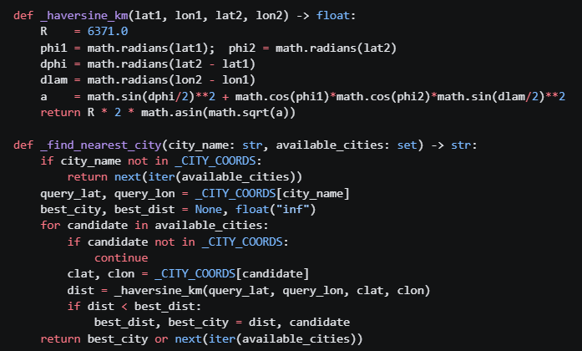
backend
Code:
Explanation:
This part of the code is used to implement Proximity Fallback Routing.
GET /api/proximity-fallback/?city=<name> routes any city through assess_outage_risk(). Inside that function, _build_city_profiles() groups grid_assets.json entries by city and averages their telemetry. If the requested city is absent from those profiles, _find_nearest_city() computes the Haversine great-circle distance (in km) from the requested city's coordinates to every city that does have data, and picks the closest. The risk_source key in the response tells the caller whether an exact match or a proximity fallback was used — e.g. "Nearest Proximity Fallback [Rajkot]". The view surfaces this as fallback_used: true/false and a human-readable distance_note.

Slide 10
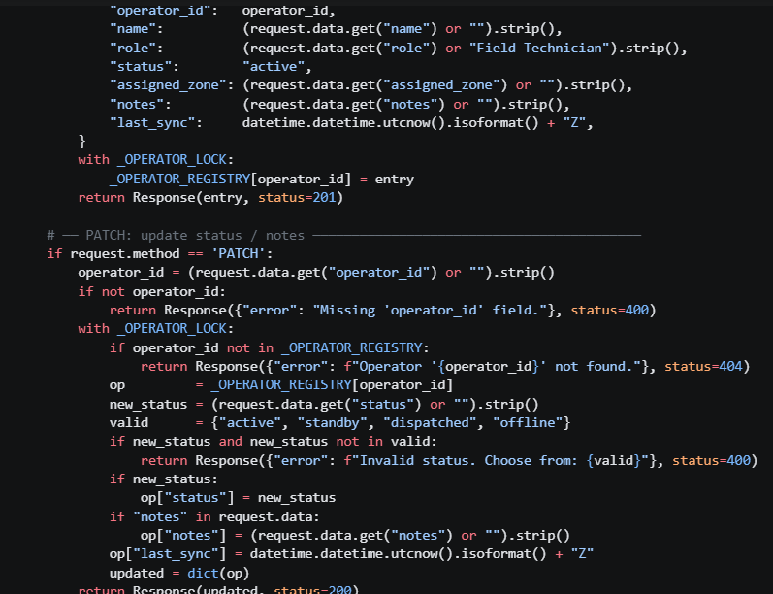
Backend
Code:
Explanation:
This part of the code is used to implement Operator Synchronization Controls
A single DRF view function at POST /GET /PATCH /api/operator-sync/ maintains a live field-operator registry entirely in-process using a plain Python dict (_OPERATOR_REGISTRY) protected by a threading.Lock. GET returns all registered operators sorted by last_sync timestamp, with an optional ?zone= filter. POST registers a new operator, setting their initial status to "active" and stamping a UTC ISO 8601 last_sync. PATCH updates only status (validated against the four allowed values: active, standby, dispatched, offline) and/or notes, refreshing last_sync on every write. All three branches acquire the lock before reading or mutating the shared dict so concurrent Django worker threads cannot race.

Slide 11
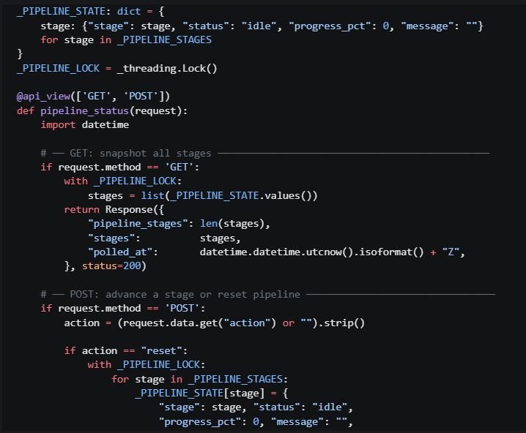
Backend
Code:
Explanation:
This part of the code is used to implement Animated Transit Pipeline.
GET /api/pipeline/ returns the live state of all 6 processing stages (data_ingestion → satellite_preprocessing → ml_inference → live_weather_fetch → risk_scoring → output_dispatch), each carrying status, progress_pct (0–100), and a message. The state is held in the module-level _PIPELINE_STATE dict protected by threading.Lock. A frontend can poll this endpoint on any interval and drive animated progress bars directly from progress_pct and colour coding from status. POST /api/pipeline/ with { "action": "reset" } wipes all stages back to idle. A targeted POST with { "stage": "ml_inference", "status": "running", "progress_pct": 60 } advances exactly one stage — both the stage name and status are validated against allowed sets, and progress_pct is auto-defaulted (50 for running, 100 for complete, 0 otherwise) if not provided.

Slide 12
Conclusion
GridGuard transforms storm-time power-grid management from a fragmented, reactive process into a unified, data-driven, and predictive response system. By combining satellite image inference, live weather data, historical proximity-based data, and asset-risk analysis through a Django-powered platform, it provides operators with an immediate 0–100% outage-risk assessment for vulnerable grid components. Its synchronized controls and visual emergency transit pipeline further help field teams prioritize high-risk locations and respond more effectively.
Overall, GridGuard bridges the gap between weather intelligence, infrastructure monitoring, and emergency field response, helping utilities detect threats earlier, reduce potential cascading outages, improve response coordination, and enhance crew safety during extreme weather events.

Slide 13
Thank you

